Slide 1

Hough Transform for Line detection
Digital Image Processing Lab
Group no. - 5
Submitted by: Rahul Kumar Meena (18EC35023)
SN Ramanathan (18EC35028)
Shreya kumari (18EC35027)
Department of Electronics and Electrical Communication Engineering
Indian Institute of Technology Kharagpur
Spring Semester 2021-22

Slide 2
Introduction
The Hough Transform is an algorithm patented by Paul V. C. Hough and was originally invented to recognize complex lines in photographs (Hough, 1962).
The algorithm has been modified and enhanced to be able to recognize other shapes such as circles and quadrilaterals of specific types.
The purpose of the technique is to find imperfect instances of objects within a certain class of shapes by a voting procedure.
This voting procedure is carried out in a parameter space, from which object candidates are obtained as local maxima in a so-called accumulator space that is explicitly constructed by the algorithm for computing the Hough transform.

Slide 3
Sobel Filter for edge detection
An edge image is the output of an edge detection algorithm. An edge detection algorithm detects edges in an image by determining where the brightness/intensity of an image changes drastically.
A very common operator for doing this is a Sobel Operator, which is an approximation to a derivative of an image. Sobel Operator tries to find out the amount of the difference by placing the gradient matrix over each pixel of image.
It is common for an edge image to be binarized meaning all of its pixel values are either a 1 or a 0.
For the Hough Transform algorithm, it is crucial to perform edge detection first to produce an edge image which will then be used as input into the algorithm.

Slide 4
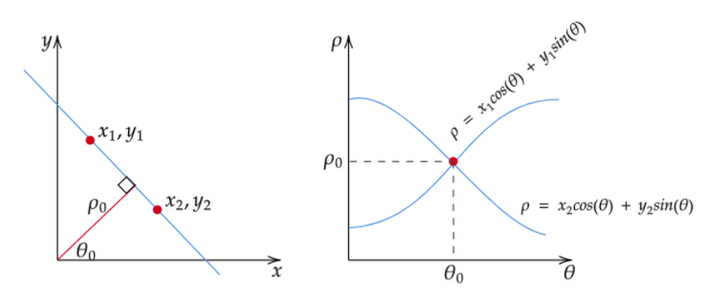
Hough Space
The Hough Space is a 2D plane that has a horizontal axis representing the slope and the vertical axis representing the intercept of a line on the edge image.
To avoid issue of infinite slopes, a straight line is instead represented by a line called the normal line that passes through the origin and perpendicular to that straight line.
The form of the normal line is ρ = x cos(θ) + y sin(θ) where ρ is the length of the normal line and θ is the angle between the normal line and the x axis.

Slide 5
Hough Space properties
A point in the picture plane corresponds to a sinusoidal curve in the parameter plane.
A point in the parameter plane corresponds to a straight line in the picture plane.
Points lying on the same straight line in the picture plane correspond to curves through common point in the parameter plane.
Points lying on the same curve in the parameter plane correspond to lines through the same point in the picture plane.

Slide 6
Hough Transform
Exactly colinear subsets of figure points can be found, at least in principle, by finding coincident points of intersection in the parameter plane. This approach is exhaustive, and the computation required grows quadratically with the number of picture points.
The computational burden can be reduced considerably by quantization of θ-ρ plane into a quadruled grid by specifying some acceptable error.
For each point (xi, yi) in the picture plane, the corresponding curve is entered in the array by incrementing the count in each cell θ-ρ of along the curve.
A given cell in the two-dimensional accumulator eventually records the total number of curves passing through it.
From accumulator lines can be determined by setting a certain threshold on count values.

Slide 7
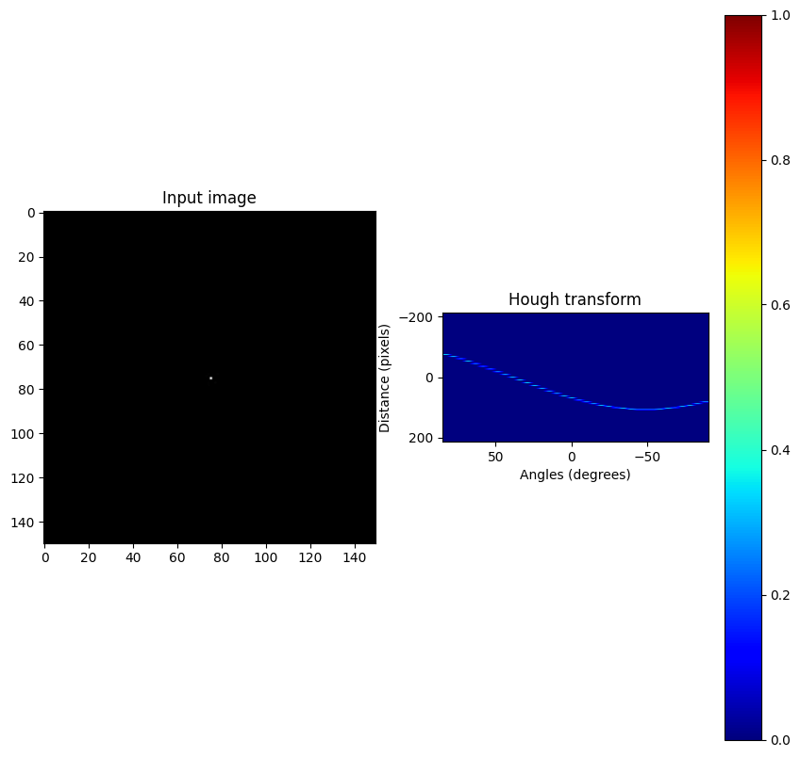
Results
One point in picture plane <-> Sinusoidal curve in parameter plane

Slide 8
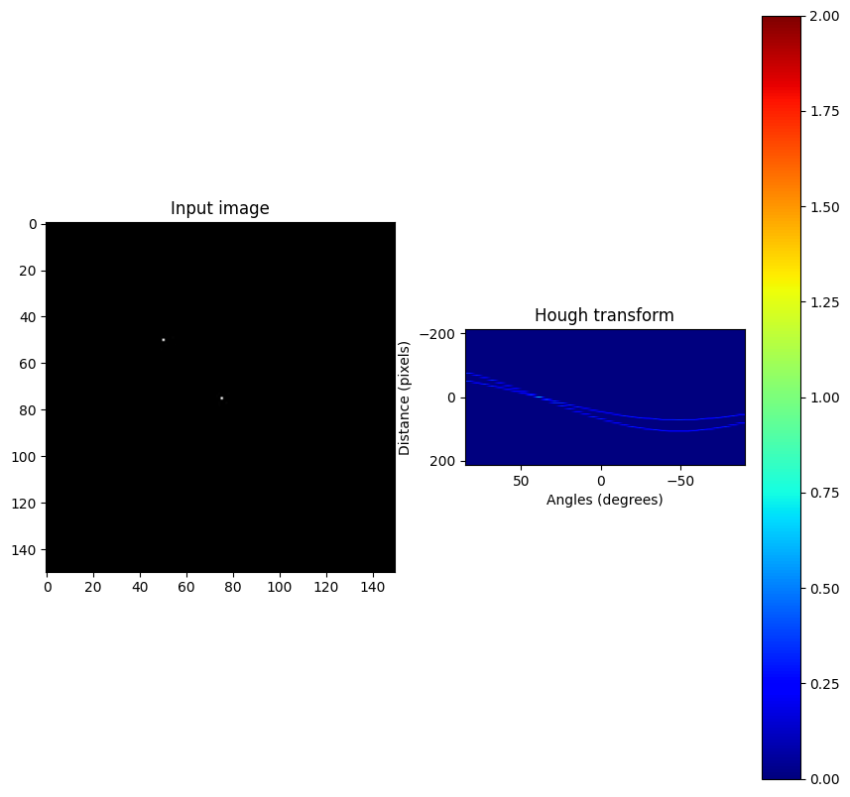
Two point in picture plane <-> Two Sinusoidal curve in parameter plane

Slide 9
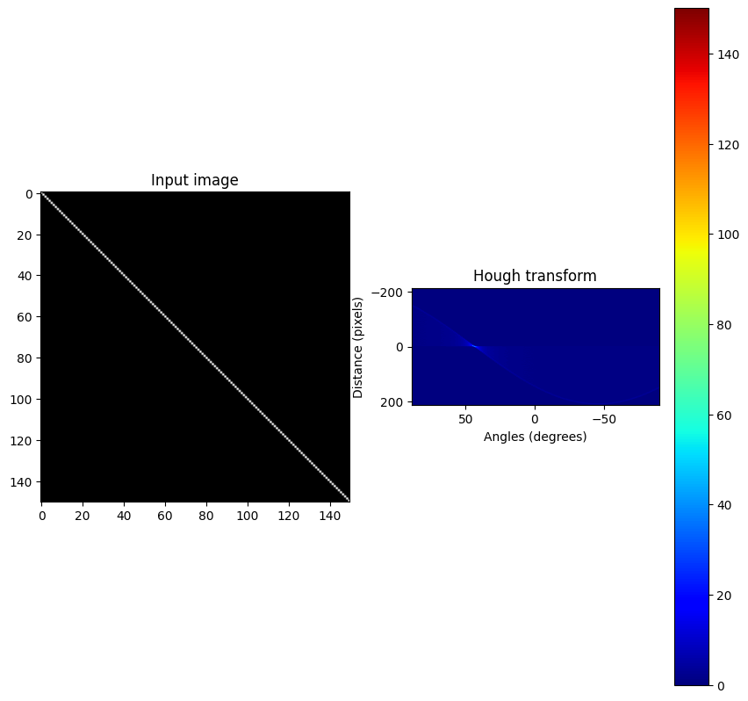
One Line in picture plane <-> Sinusoidal curves through single point in
parameter plane

Slide 10
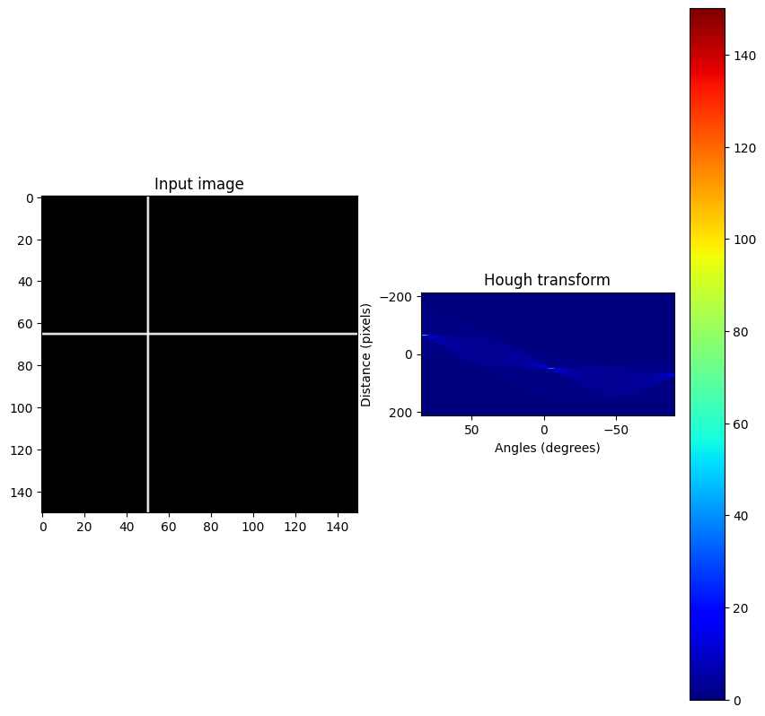
Two Lines in picture plane <-> Sinusoidal curves through two point in
parameter plane

Slide 11
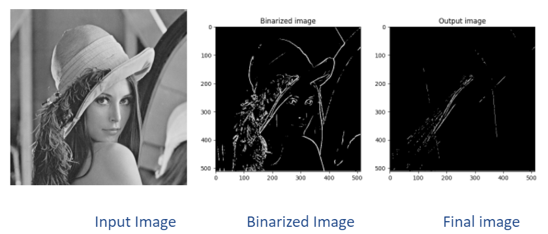
Hough Transform on Normal Images:

Slide 12
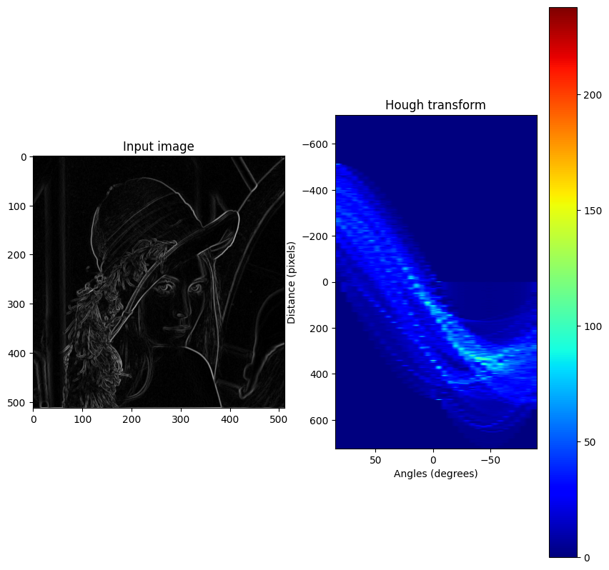
Edge detected Image and Hough Transform

Slide 13
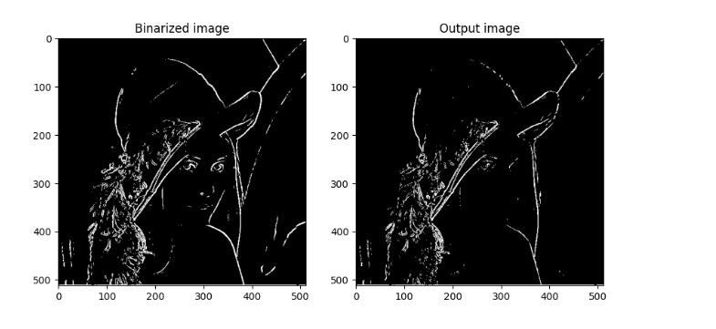
Binarized Image Final image(decreased Accum. threshold)

Slide 14
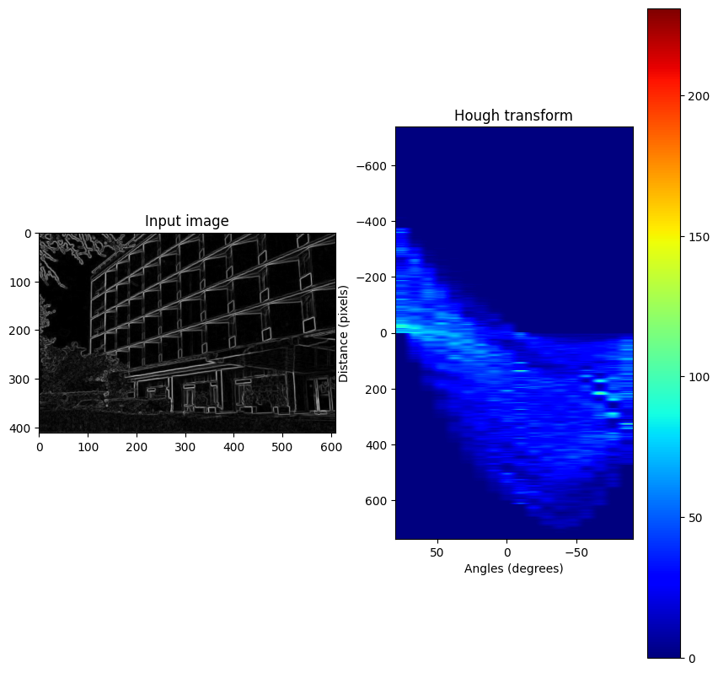
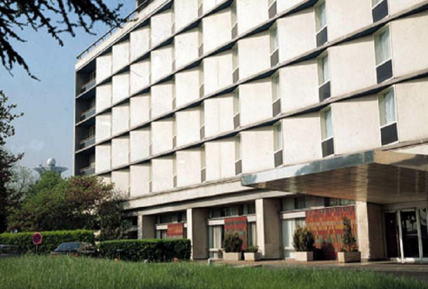
Input Image
Edge detected Image and Hough Transform

Slide 15
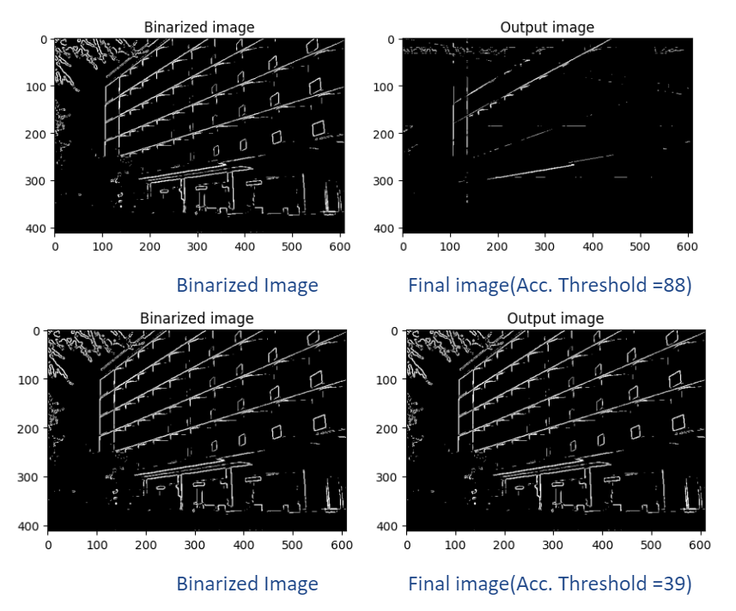

Slide 16
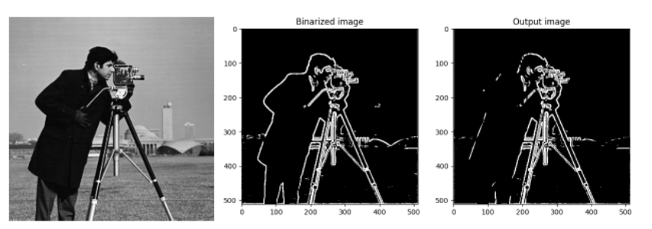
Input Image

Slide 17
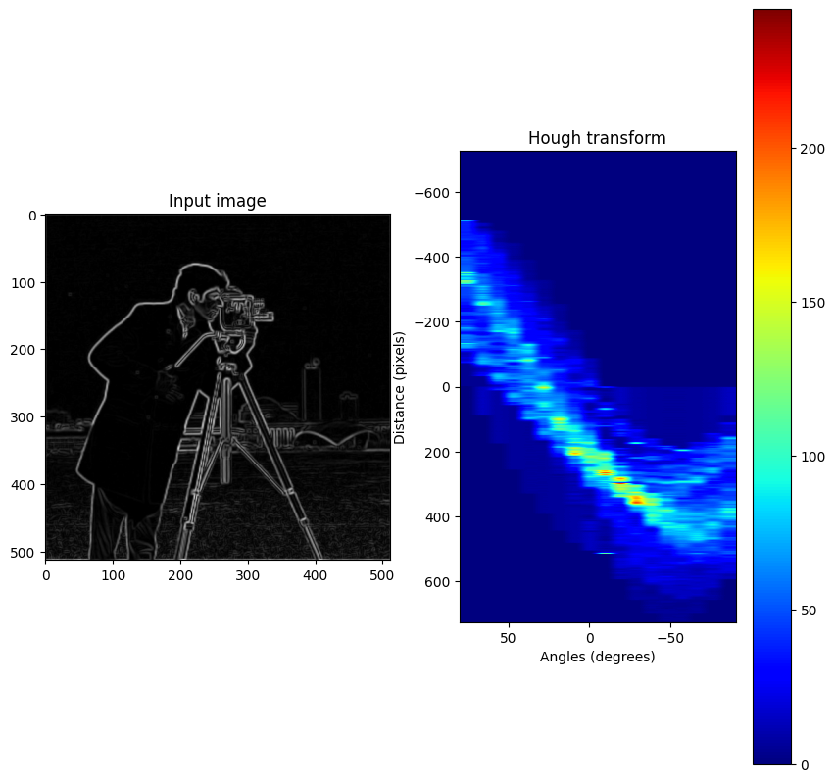
Edge detected Image and Hough Transform

Slide 18
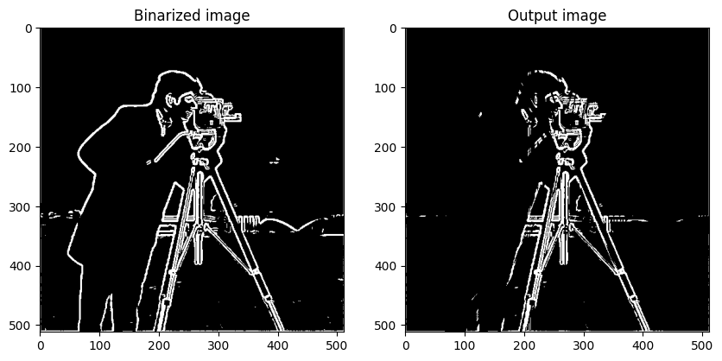

Slide 19
Limitations
The results are sensitive to the quantization of both θ and ρ. Finer quantization gives better resolution, but increases the computation time and exposes the problem of clustering entries corresponding to nearly collinear points.
The technique finds collinear points without regard to contiguity. Thus the position of a best-fit line can be distorted by the presence of unrelated figure points in another part of the picture. Meaningless groups of collinear points being detected.

Slide 20
References
Duda, Richard O., and Peter E. Hart. "Use of the Hough transformation to detect lines and curves in pictures." Communications of the ACM 15.1 (1972): 11-15.
Lines Detection with Hough Transform - Socret Lee
Thank You

